Slide 1
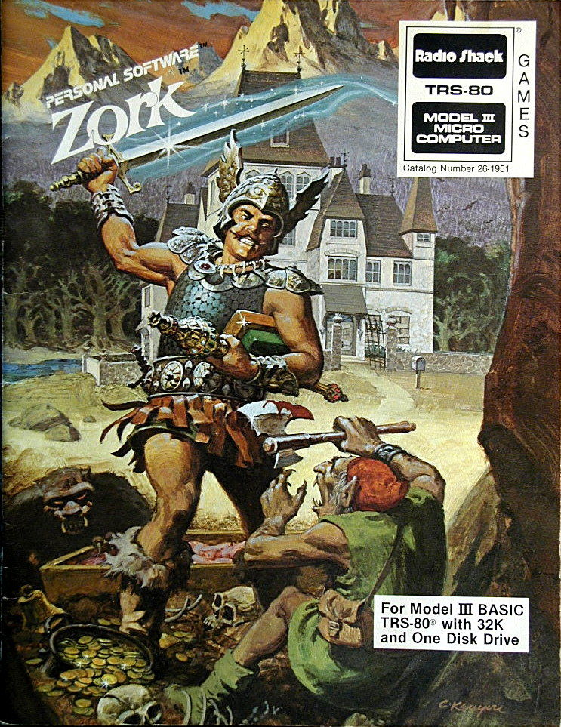
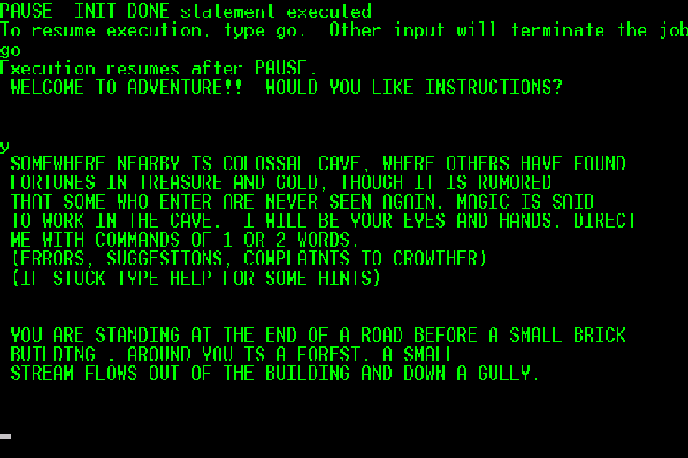
The legend of ogoroth
Enjoy a text-based adventure filled with choices, danger, excitement, and more!
Contributors:Andrew Countryman and Logan Pritchett - https://github.com/LoganPritchett/Text-Adventure
Original code: abhishek5670

